Slide 1
An Experimental Study for Crop Disease Detection using CNN
AN EXPERIMENTAL STUDY FOR CROP DISEASE DETECTION USING CNN
AP18110010142-Retheshna AP18110010159-Harika
AP18110010186-Vindhya AP18110010188-Radhika

Slide 2
Problem Statement:
It is necessary to help farmers in automatically detect symptoms of disease as soon as they appear by analysing the digital images which may helping us for:
Minimizing major production and economic losses.
Ensuring both quality and quantity of agricultural products and
Minimizing agrochemicals use.

Slide 3
Introduction:
Crop diseases cause major losses in production and economically in agricultural industry world wide.Early information on crop health and disease detection can facilitate the control of diseases

Slide 4
Objective:
The objective of this challange is to build an expert model to predict if a crop is healthy or effected using CNN.

Slide 5
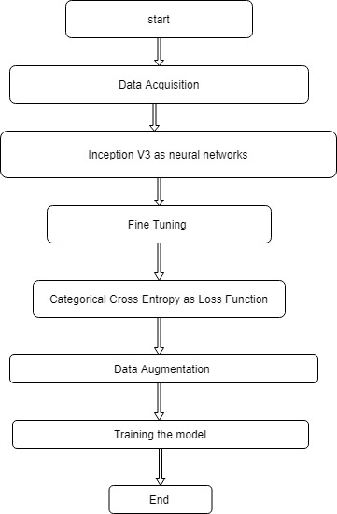
Proposed Methodology :

Slide 6
Data acquisition:
The New Plant Disease Data set which is provided by kaggale website contains 22930 images belonging to 10 diseases of tomato leaves.
Th

Slide 7
Inception v3:
It is a Convolutional Neural Network (CNN) Model
It has “ImageNet” which contains Millions of images which belongs to 1000 classes
The building blocks of inception v3 are convolutions,max pooling,concats, drop outs, fully connected layers and average pooling.
Feature extraction is done during this stage which helps model to clearly distinguish between all the characteristics of image.

Slide 8
Fine Tuning:
Freezing the layers which are already trained by Inception V3.

Slide 9
Loss function:
Loss function is Categorical cross entropy(As we have 10 different classes).
Optimizer :
Adam is an optimizer which is best among the others to reduce the loss.

Slide 10
Data Augmentation:
The image data is generated by transforming the actual training images by
rescale,
shear_range,
zoom_range,
horizontal_flip.

Slide 11
Performance evaluation:
The model gives 87.74% accuracy on validation set while training the model.The Cnn model learns to represent features of diseases from the training images.

Slide 12
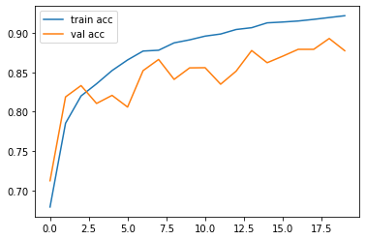
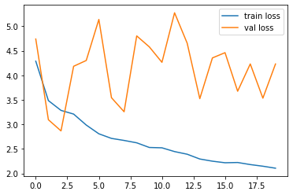
Plotting accuracy and loss:

Slide 13
Under the guidance of
Dr.Neeraj sharma
SRM University AP
Thank You!

